Slide 1
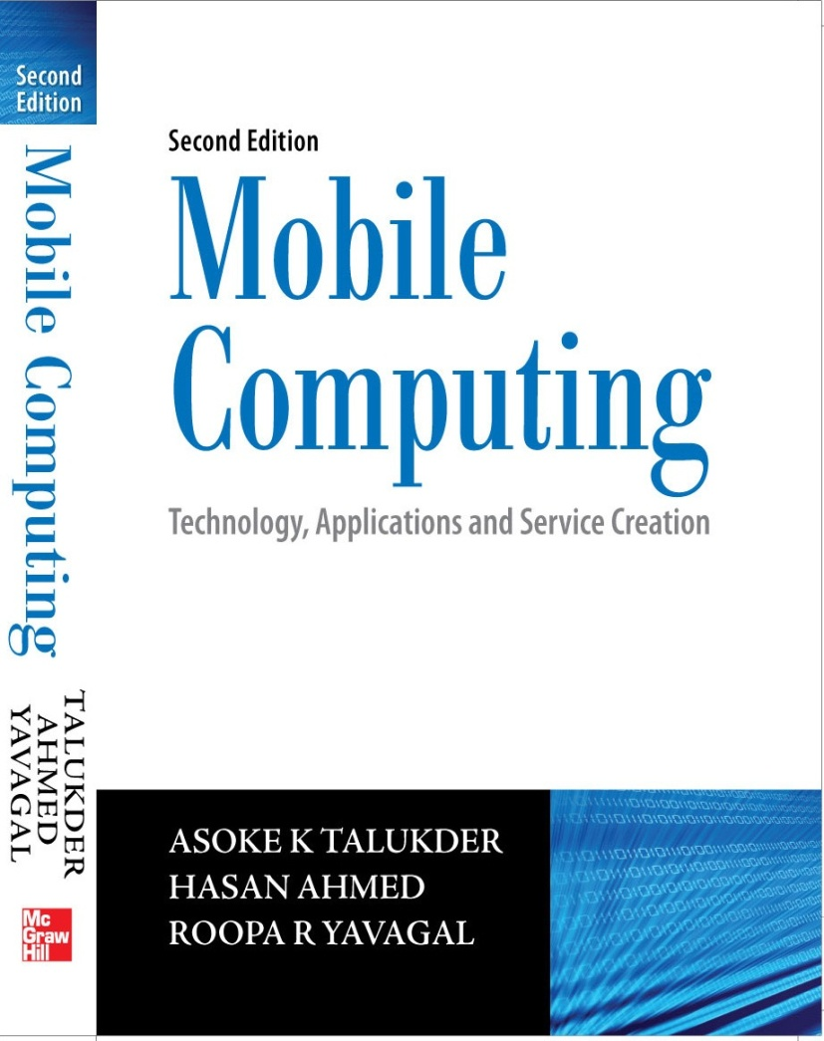
Notes#13
Next Generation Networks

Slide 2
NGN – All about convergence
Next generation Network implies a judicious blend of Internet, broadband, cellular telephony and TV into a technological mosaic that best combines the advantages of communications covering their limitations.
ITU defines NGN as a “packet-based network able to provide services including Telecommunication Services and able to make use of multiple broadband, QoS-enabled transport technologies and in which service-related functions are independent from underlying transport related technologies”.

Slide 3
NGN – Offering convergence
Seamless blend of PSTN and PSDN
Central Office functions’ pushed to the edge of the network with distributed network infrastructure GUI
Can be thought of as object oriented networks where objects are various services
Advantage is that services can be created quickly and commissioned at a low cost

Slide 4
All in one – Converged scenario
Convergence of voice and data
Convergence of wireline and wireless
Convergence of Packet switching and Circuit switching
Convergence of IT and CT
Convergence of Operations Support Systems and Business Support Systems

Slide 5
Narrowband to Broadband
Use of Multimedia data
Demand of higher bandwidth
Users want unified content over diverse bearers and devices
Requirement of “Always On” network

Slide 6
DSL Broadband Networks
Digital Subscriber Lines (DSL) provide data services over the wires of a local telephone network
DSL takes advantage of unused bandwidth of the local loop
DSL can be asynchronous or synchronous
Asynchronous DSL (ADSL) is used when required bandwidth for download is higher than that of upload
Synchronous DSL is suitable for interactive services or VoIP

Slide 7
WiMAX Broadband Wireless Networks
Worldwide Interoperability for Microwave Access (WiMAX) can be either fixed or mobile.
Fixed WiMAX deployments do not cater for handoffs between Base Stations (BS) and hence, offer restrictive mobility.
Mobile WiMAX offers facilities of handoffs that can be used to deliver both fixed and mobile services.
In urban areas without Line of Sight (LoS), users may perceive a speed of 10 Mbit/s over a range of 2 kilometres.

Slide 8
High Speed Broadband Cellular Networks
High Speed Packet Access (HSPA) is a suite of mobile telephony protocols that aims to extend and improve the performance of existing UMTS family of protocols.
Better performance is achieved using improved modulation schemes and by fine-tuning the protocols by which cellular handsets and base stations communicate.
Two flavours of HSPA – HSUPA and HSDPA

Slide 9
HSUPA
High Speed Uplink Packet Access (HSUPA) aims to increase capacity and throughput and reduce delay.
HSUPA uses enhanced dedicated channel on which it employs link adaptation methods which help in faster link adaptation and effective retransmissions.
HSUPA provides uplink speeds up to 5.76 Mbit/s.

Slide 10
HSDPA
High Speed Downlink Uplink Packet Access (HSDPA) improves downlink performance using faster scheduling of packets and quick retransmissions (at the base stations) and Adaptive Modulation and Coding (AMC).
HSDPA provisions downlink speeds of 1.8, 3.6, 7.2 and 14.4 Mbit/s.

Slide 11
WiBro
Wireless Broadband (WiBro) is South Korean name for IEEE 802.16e (mobile WiMAX) standard.
WiBro provides mobility for moving devices up to 120 km/hr.
WiBro adapts Time Division Duplexing (TDD) and OFDMA while using 8.75 MHz as channel bandwidth.

Slide 12
B3G Network
Beyond 3G (B3G) Network also known as All IP Network (AIPN) and 4G network
Transition towards an “All-IP based network infrastructure”
Support of heterogeneous technologies
Seamless handover across both homogeneous and heterogeneous wireless access technologies
Multilayer Mobility Management suitable to support fast mobile users that may access a wide range number of services with diverse characteristics
QoS support on the IP layer

Slide 13
B3G Network
Use of policy-based mechanisms in order to determine QoS, accounting, and billing mechanisms for multimedia services
Network access control of mobile users regardless of heterogeneous wireless access network used
Distributed AAA architecture for the dynamic establishment of trust relations in hybrid IPv4/IPv6 networks
Secure access to multimedia services across different networking environments
Access to multimedia services in hybrid IPv4/IPv6 based networks

Slide 14
B3G Network
It will offer RASP that includes reliability, availability, security, and performance
More users per cellular cell
A highly efficient spectral system
Backward compatibility with existing wireless standards

Slide 15
OFDM
Orthogonal Frequency Division Multiplexing
Optimal version of the multi-carrier data transmission scheme
Based on the principle of spreading the data to be transmitted over a large number of carriers when each of them is being modulated at a low rate
Orthogonality helps in elimination of cross-talk between the sub-channels and the use of inter-carrier guard bands

Slide 16
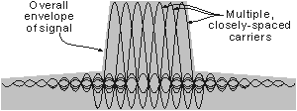
OFDM Spectrum
Data to be transmitted on an OFDM signal is spread across the carriers of the signal wherein each carrier takes part of the payload
Data is sampled only when the signal is stable and no new delayed signals arrive that would alter the timing and phase of the signal

Slide 17
Advantages of OFDM
High spectral efficiency
Facilitation of transmitter macro-diversity
Robustness against Inter Symbol Interference (ISI) and severe channel circumstances
Services using OFDM are DSL, WiMAX, DAB (Digital Audio Broadcast), DVB (Digital Audio Broadcast), 3GPP LTE, etc.

Slide 18
FAMA
Fixed Assignment Multiple Access
Applications of FAMA protocol are characterized by the assignment of capacity in a fixed manner amongst multiple stations
Stations are assigned a fixed channel capacity
FAMA protocols assign a static portion which can be in terms of time, frequency, code or space, of the overall link capacity to different stations
Assignment of resources are fixed and do not change according to station traffic patterns
FAMA based protocols can provide bounds for delay performance which becomes of paramount importance in real time applications

Slide 19
DAMA
Demand Assignment Multiple Access
DAMA protocols assign channels to stations based on the traffic information in the network
Assignment of channels is achieved through reservation or polling techniques so that the each station can express their interest in using the channel for transmission based on its own traffic information
DAMA protocols can be collision free, in which each station is assigned a fixed reservation slot, or it can be collision based, in which each station needs to compete with other stations when transmitting requests

Slide 20
MPLS
Multi Protocol Label Switching
Also known as 2.5 layer protocol
MPLS makes the use of labels for data forwarding decisions
Provides a unified data carriage service for different traffic categories like IP packets, frames of ATM and SONET
MPLS supports both Packet switched and Circuit switched data
MPLS working group aims to standardize a base technology which can combine the use of label swapping in the forwarding component with network layer routing in the control component

Slide 21
MPLS
MPLS can run over any link layer technology while supporting both unicast and multicast traffic flows
MPLS is scalable enough to support Internet growth while being compatible with the IETF Integrated Services Model and its related protocols
MPLS supports current IP network operations
MPLS helps multi-vendor interoperability

Slide 22
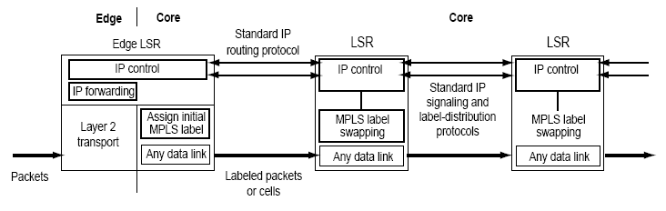
MPLS
MPLS initiates assignment and distribution of label bindings for the establishment of Label Switched Paths (LSPs)
LSPs provision a packet to be forwarded from one Label Switching Router (LSR) to another LSR across the whole of MPLS domain
Through MPLS, network layer header analysis is done when the packet enters its domain and this label inspection drives subsequent packet forwarding across the whole of domain

Slide 23
Applications of MPLS
Traffic Engineering - MPLS facilitates Traffic Engineering to allow ISPs to move traffic flows away from the shortest path onto potentially less congested physical paths across the network.
Class of Service - MPLS offers great flexibility to the ISPs in terms of different types of services that they can provide to their customers
Virtual Private Networks - MPLS lets ISPs to offer VPN services by providing a flexible and powerful tunneling mechanism

Slide 24
WATM
Wireless Asynchronous Transfer Mode
WATM adds up the mobility advantages to the ones provided by ATM networks
A wireless access point connects the set of wireless nodes while servicing on a single port of ATM switch
WATM incorporates features of ATM like speed, scalability, multimedia integration and uniform API features with good cost performance

Slide 25
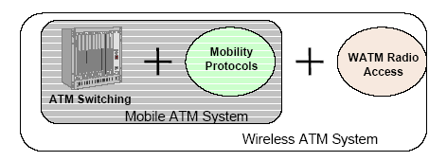
WATM
Wireless/Mobility protocols are incorporated into standard ATM stack keeping the following as mandatory:
ATM cell as basic unit in both wireless and backbone
Standard ATM services at transport interface
Custom medium access and data link control for wireless segment
Mobility extensions to ATM signaling: handoff and location management

Slide 26
WATM
Three basic service scenarios for WATM are:
Providing mobility support in IP
Mobile Telephony
Wireless ATM systems

Slide 27
DAB
Digital Audio Broadcast
Uses OFDM modulation technique
DAB offers substantially higher spectral efficiency, measured in programmes per MHz and per transmitter site, than analogue communication
DAB carries program guides that is called Dynamic Label Segment from the station giving real-time information such as song titles, music type and news or traffic updates
The new DAB+ standard has adopted the HE-AAC (High Efficiency Advance Audio Coding) version 2 audio codec and it will help broadcasters provide a combination of both higher audio quality and more stations will be provided

Slide 28
DVB
Digital Video Broadcast
DVB delivers compressed images, sound/music or data to the receiver
No restrictions exist as to the kind/format of information in the data containers
Service information in DVB acts like a header to the container ensuring that the receiver knows what it needs to decode
The major objective of DVB project is to reap the benefits of technical standardization while satisfying the commercial requirements of the project member
DVB is useful for data broadcasting services such as access to World Wide Web

Slide 29
DVB
The specifications in DVB concern:
general aspects of digital broadcasting
channel coding
source coding of audio, data and video signals
transmitting DVB signals over terrestrial and satellite communications paths
scrambling and conditional access
software platforms in user terminals
user interfaces supporting access to DVB services
the return channel for support purposes
interactive services

Slide 30
IPTV
Television broadcast over the Internet Protocol is called IPTV
Uses a two-way digital broadcast signal sent through a switched telephone or cable network by way of a broadband connection and a set-top-box (STB)
STB is programmed to allow only these channels that the subscriber has already paid
IPTV covers both live TV as well as stored video through Video on Demand
Video content is typically compressed using either a MPEG-2 or a MPEG-4 codec and then sent in an IP Multicast in case of live TV or via IP Unicast in case of Video on Demand

Slide 31
Internet TV
Refers to transport streams sent over IP networks (normally the Internet) with receiver station being a PC or computer
An Internet TV provider has no control over the final delivery and so broadcasts on a ‘best effort’ basis
One main difference between IPTV and Internet TV is that IPTV are paid services that carry both free channels and paid channels whereas, Internet TV is generally free

Slide 32
Multiple Play
Describes provision of diverse telecommunication services by vendors that usually offered one or two of such services
Generic term for conglomeration of more than service into a single product or service
Two popular categories: Triple Play and Quadruple Play

Slide 33
Triple Play
Provisioning of two broadband services - high-speed Internet access and television, and one narrowband service - telephone over a single broadband connection usually delivered over a DSL link
Television contents are delivered through DVB technology
Internet access is usually provided through an Ethernet port while voice services can be provided using either existing telephone network or Voice over IP
No standard configurations to offer Triple Play services
Business challenges lie in ascertaining the right business model, backend processes, customer care support and capital expenditure

Slide 34
Quadruple Play
Can be thought as Triple Play plus mobility through wireless technologies
Due to advantages garnered by IP and IMS, users can enjoy a consistent user experience across various devices and access networks
IP provides a cost efficient way to converge voice, data and video transport onto a unified network infrastructure
IMS provides the next generation network architecture that converges voice, data and IPTV service attributes over multiple access types into a rich and consistent user experience
Still a long way to be popular amongst subscribers

Slide 35
3GPP LTE
3GPP Long Term Evolution (LTE) will be a wireless broadband Internet system with other services (like voice and data) built over it and expected to be in release 8 of current UMTS system
Backward compatibility with legacy standards
Optimal cell sizes
Better download and upload rates
Small latencies for small IP packets
Increased spectrum flexibility with slices as small as 1.25 MHz supported

Slide 36
iBurst
iBurst or High Capacity Spatial Division Multiple Access (HC-SDMA) is a wireless broadband technology which optimally uses the available bandwidth by using smart antennas
Provides wide area broadband wireless connectivity for fixed, portable and mobile computing devices
Can be implemented with smart antenna array techniques to substantially improve the radio frequency coverage and performance of the system

Slide 37
Thanks

